Slide 1
Tobias Mahlmann and Mike Preuss
CIG 2012 StarCraft competition
September 14, 2012

Slide 2
Submissions
Botname | Race | Contributor
Nova | Terran | Alberto Uriarte | Drexel University
Skynet | Protoss | Andrew Smith | none
SCAIL | Protoss | Jay Young | The University of Birmingham
AIUR | Protoss | Florian Richoux | University of Nantes
BroodwarBotQ | Protoss | Gabriel Synnaeve | INRIA, Collège de France
Xelnaga | Protoss | Ho-Chul Cho | Sejong University
BTHAI | Terran | Johan Hagelbäck | Blekinge Institute of Technology
Adjutant | Terran | Nicholas Bowen | University of Central Florida
IceBot | Terran | Wang Zhe | Ritsumeikan University
UalbertaBot | Protoss | David Churchill | University of Alberta

Slide 3
Basic Rules
90 rounds of round robin on 6 maps (= 15 times each bot against each on every map)
games played in highest possible speed, set by tournament software (from Alberta people)
bots ordered according to overall winning rate
crashing or timeout means win for opponent
hour timeout (=85716 frames) means draw
due to technical problems, read/write feature constraint to games on a single computer (of 6)

Slide 4
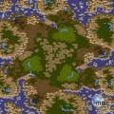
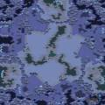
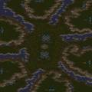
Maps
3 3-player maps:
Athena-II Neo Moon Glaive Tears of the Moon
3 6-player maps:
Legacy River of Light The Huntress 1.1

Slide 5
Cooperation with AIIDE People
tournament software provided by University of Alberta team (Michael Buro, David Churchill, Jason Lorenz)
client-server system, clients can enter any time (2 per game needed)
starcraft/bot crashes handled automatically
note: very similar setup to AIIDE’12, only our maps were not known in advance

Slide 6
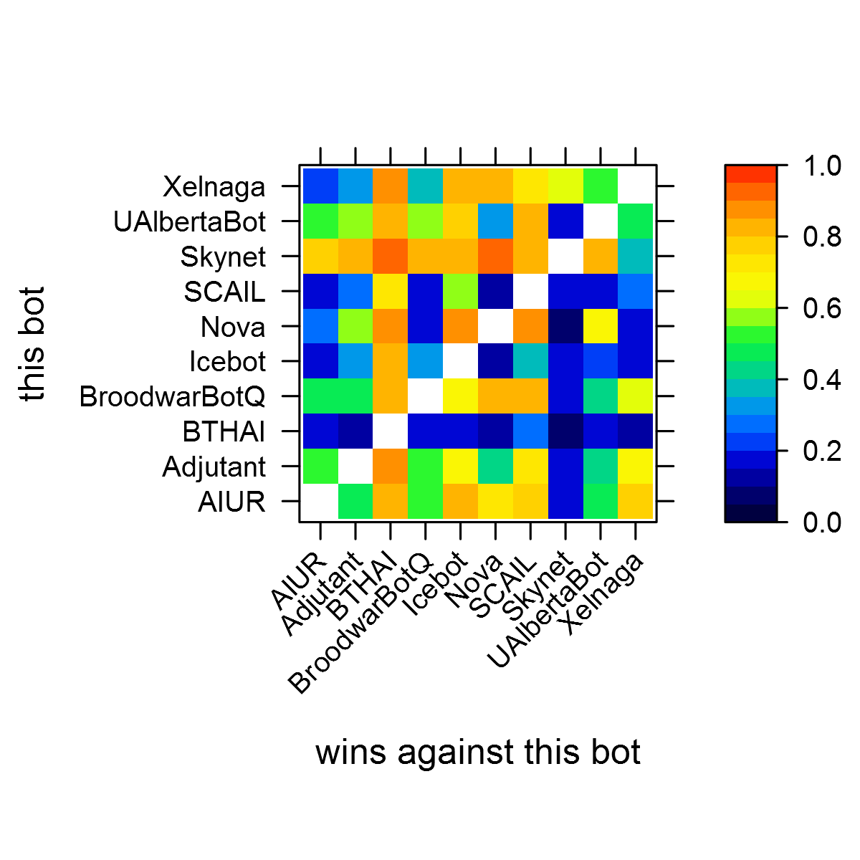
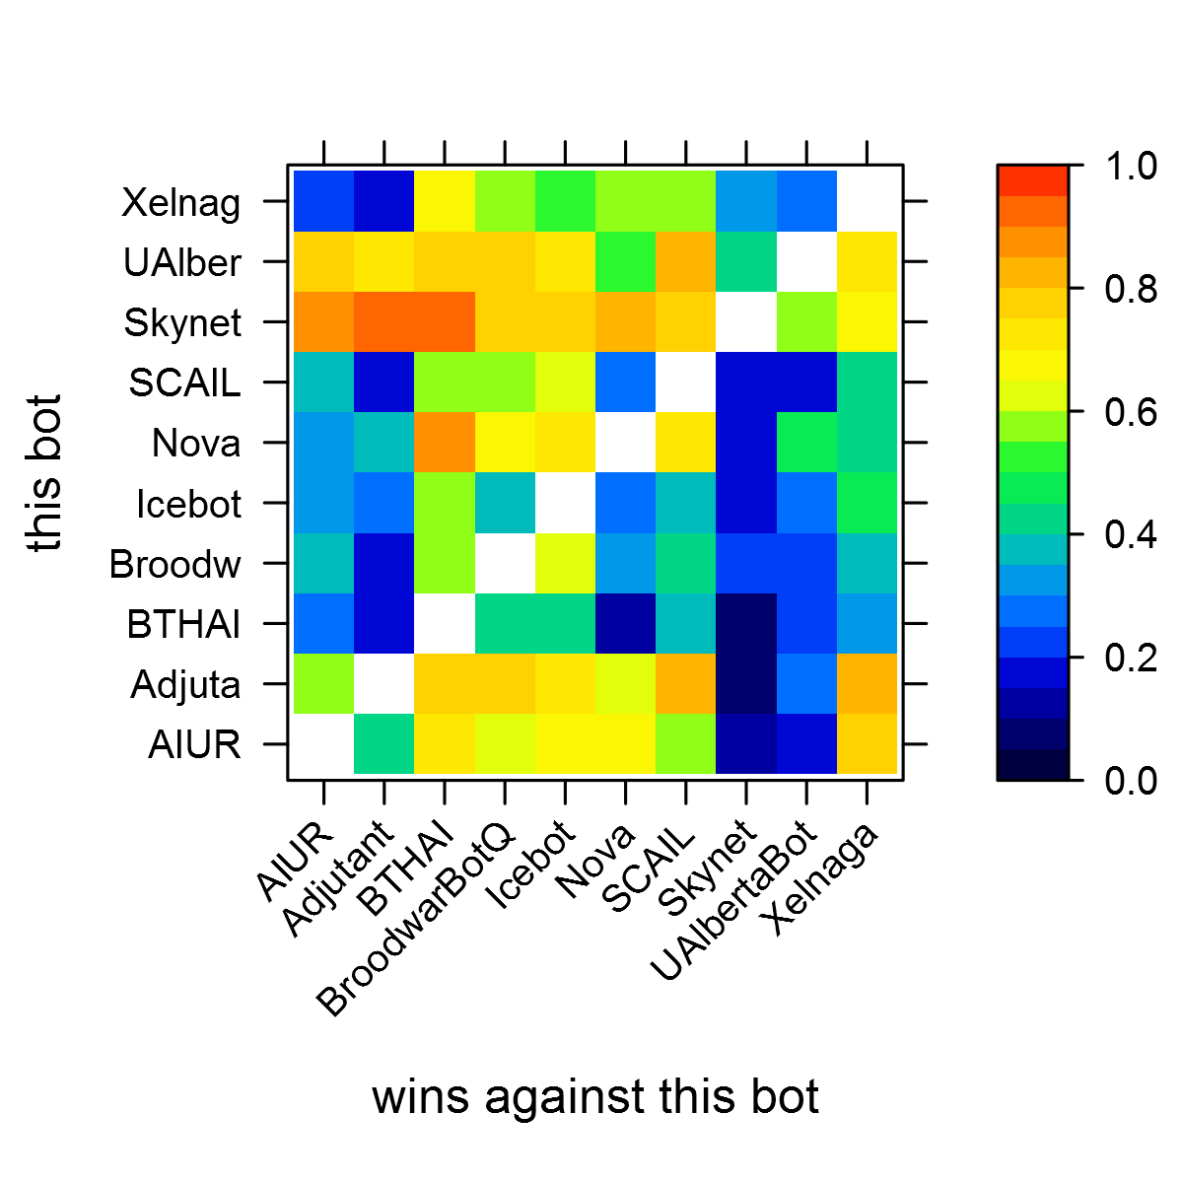
3 Player Maps (Left), 6 Player Maps (Right)

Slide 7
Some Observations
map ‘size‘ has an effect!
Nova against BBQ: good on 6-player, bad on 3-player
SCAIL and Adjutant better on 6-player, BBQ worse on 6-player
UAlbertaBot better on 6-player (due to scouting?)
Nova consistently good against UAlbertaBot
Xelnaga only bot to beat Skynet, but only on 3-player maps

Slide 8
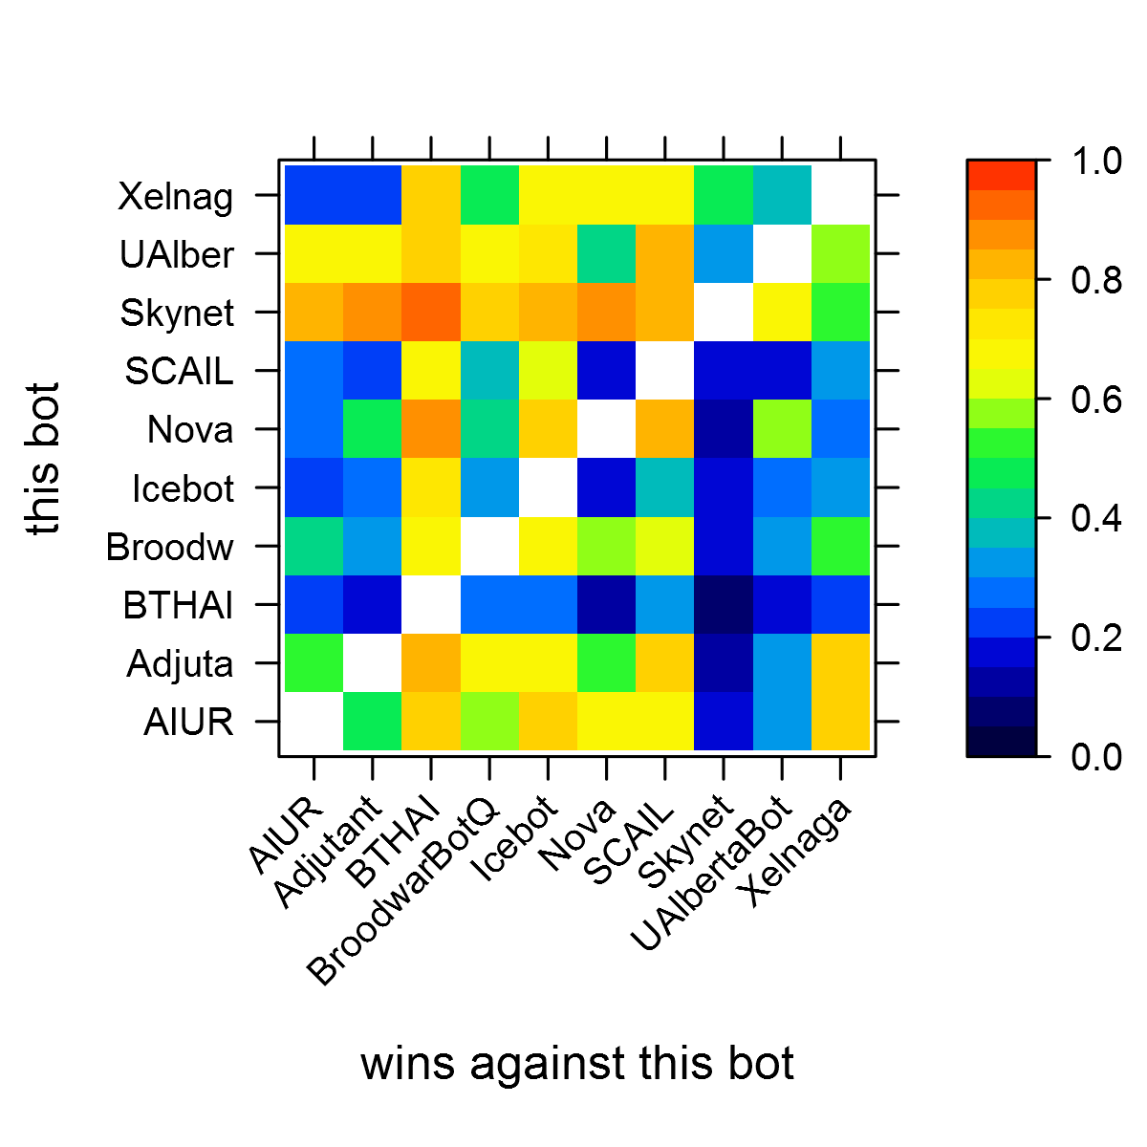
Averaged over all 6 Maps

Slide 9
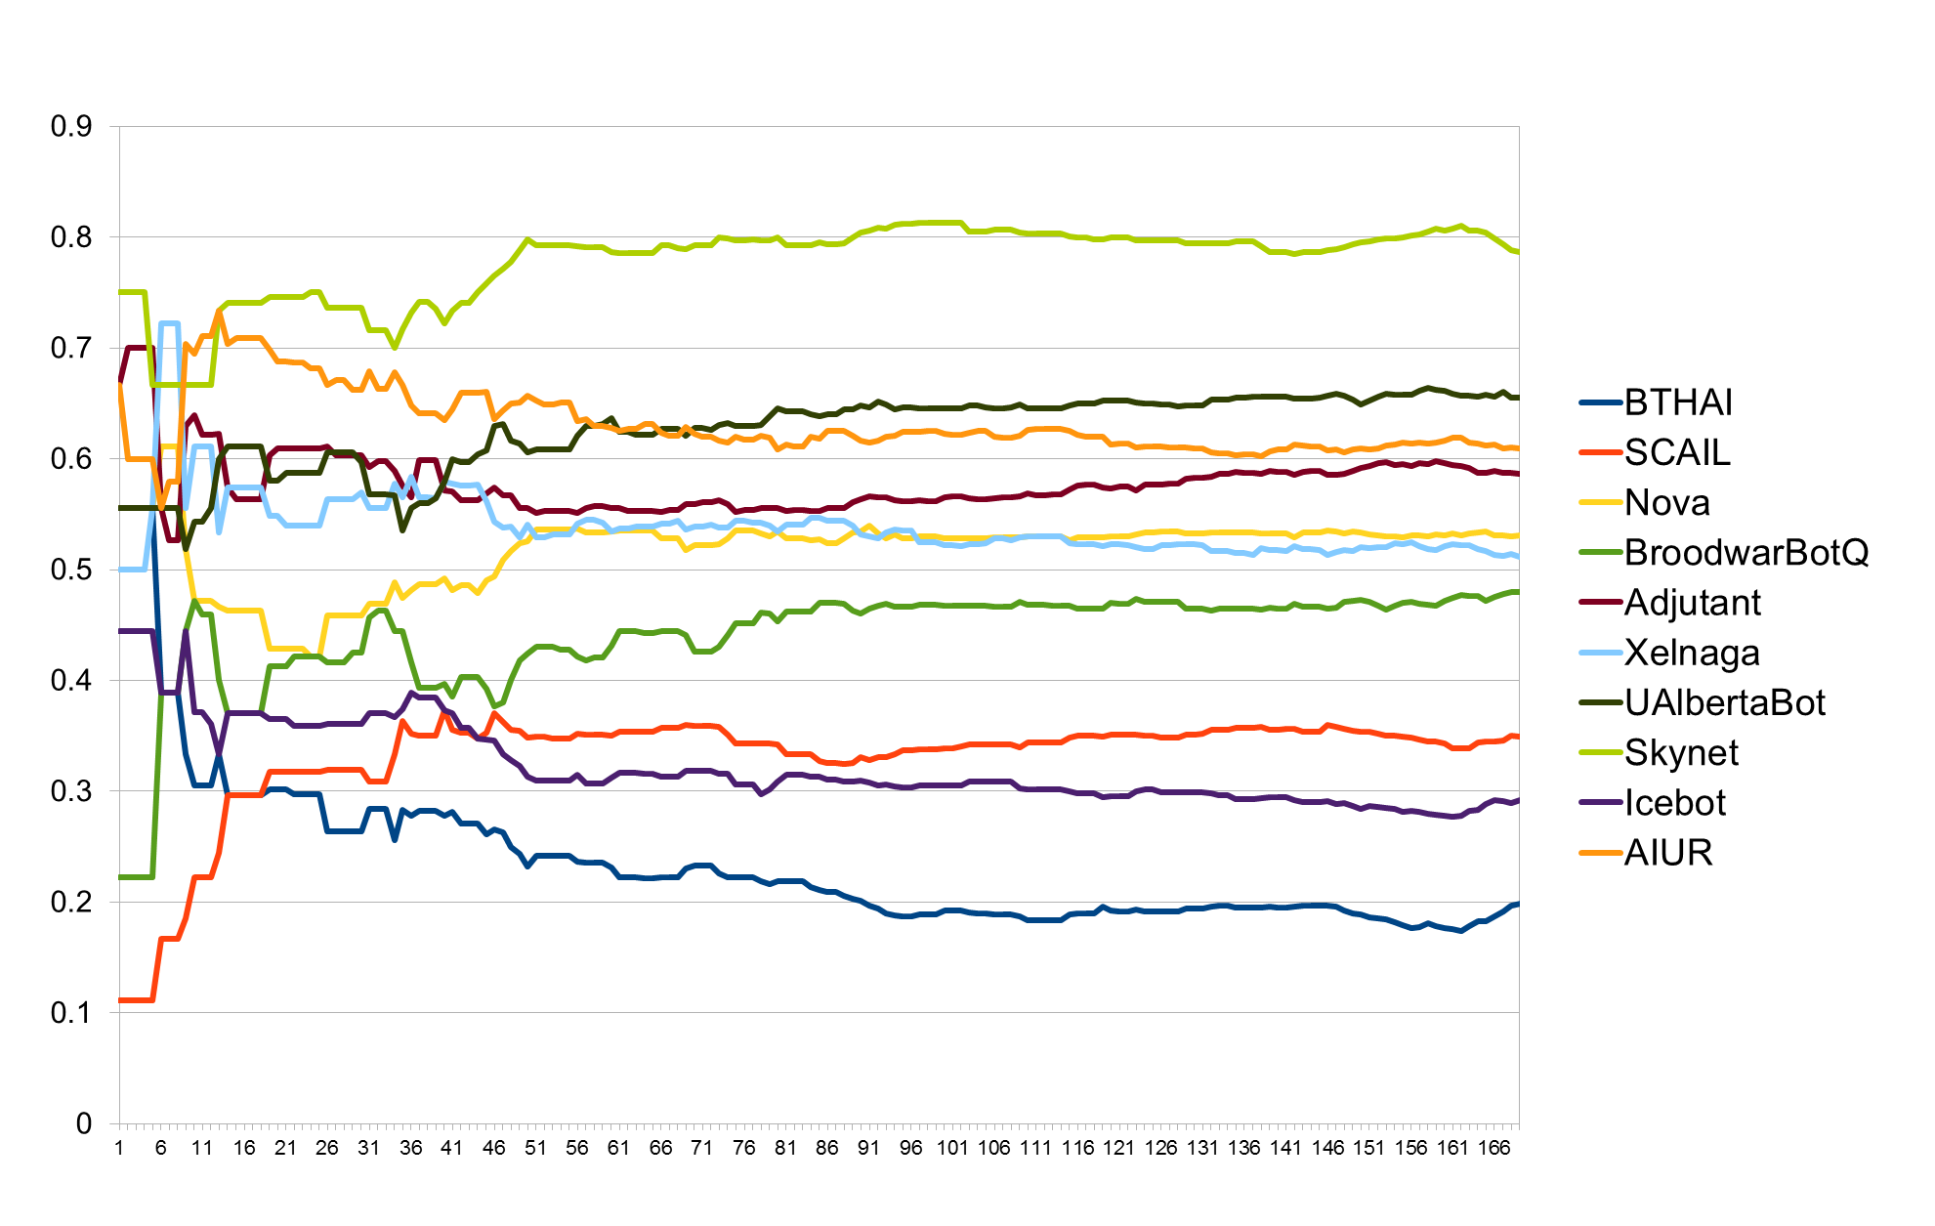
Overall Win Rate History

Slide 10
The Medalists
3rd: AIUR, Florian Richoux
2nd: UAlbertaBot, David Churchill
1st: Skynet, Andrew Smith
and, honorary mention to:
Adjutant, Nicholas Bowen
(1st time, best terran)

Slide 11
Summary
things (many) bots can‘t do:
handle islands
play zerg
play maps of different sizes (!!!)
play against random race
finish off beaten opponent
adapt to opponent strategy
cooperate (no teamplay)

Slide 12
The Future
still many problems, but:
huge step in average bot performance (see BTHAI as ‘baseline’)
we need to change basic approach: not re-implement everything, but use available stuff
finally come up with useable modules
bots need to become more flexible
very interesting: step into team AI
overall: we are getting to the interesting phase now!
use tournament software for research!

